Slide 1

Data Science 104
Visualisation

Slide 2
Proposed Plan
 | Title | Description | Exercise
1 | Python 101 | Intro to syntax and core concepts | Python workbook
2 | Data Analysis | Analysis libraries (numpy and pandas) | CO2 Analysis
3 | Databases | DB storage and SQL | Build own database
4 | Visualisation | Sexy graphs, charts, and wordclouds | Colourful visualisation
5 | Machine Learning | Simple models | Regression & Decision Trees?
6 | Machine Learning | Complex models | Visual recognition
7 | Watson Integration | Integrating with Watson cloud services | Watson labs

Slide 3
Outline
Pictures worth a 1000 words
Walkthrough
Basic Charts
Maps
Data pre-processing
Time Series Maps
(Optional) Homework
Wordclouds

Slide 4
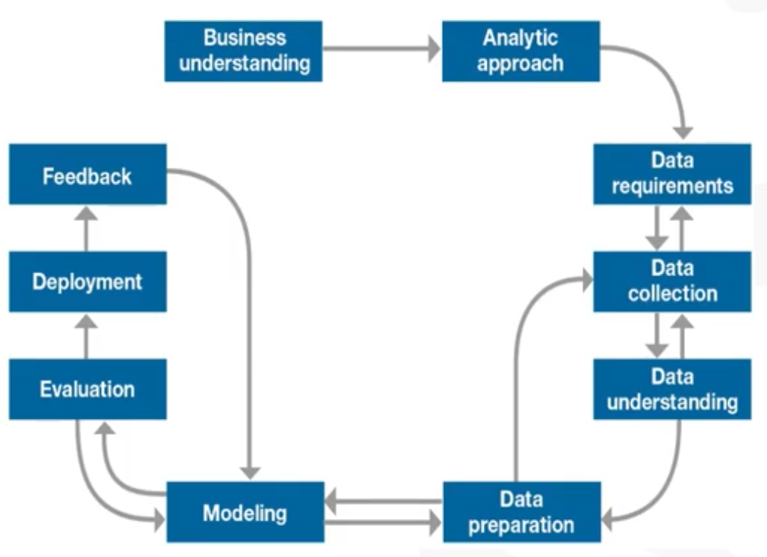
Almost always useful

Slide 5


Libraries
Great MatPlotLib Tutorials
The OG
Comprehensive library for all kinds of visualisations
Based on matplotlib
High-level interface
Some things are easier in Seaborn
Lots of other add-ons libraries!
Great Seaborn Tutorials

Slide 6
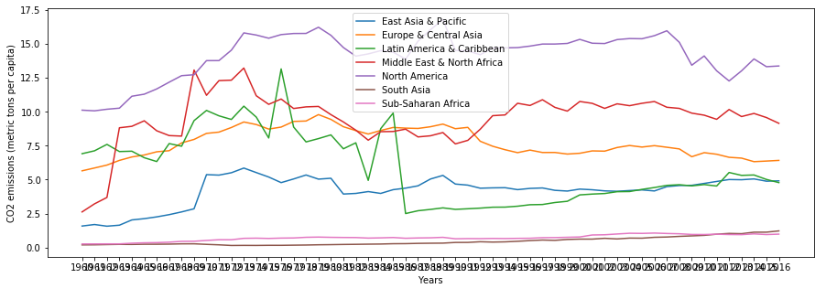
Examples
Full code examples. Check out: https://matplotlib.org/tutorials/introductory/sample_plots.html

Slide 7
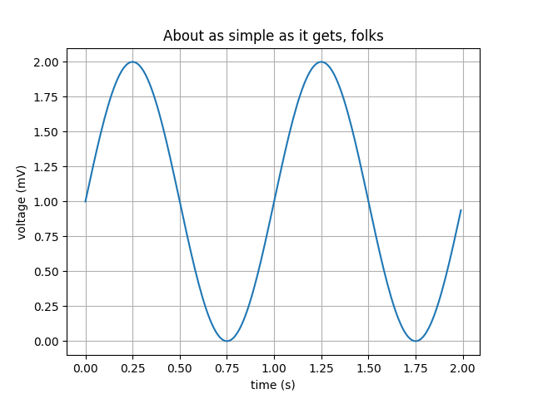
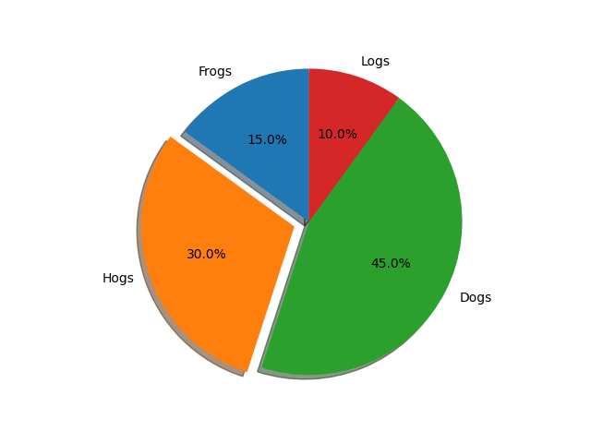
Simple Plots

Slide 8
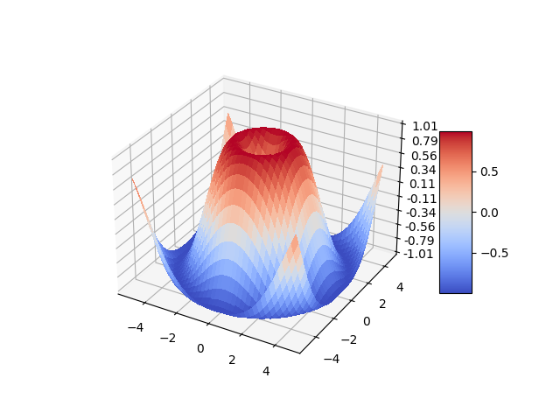
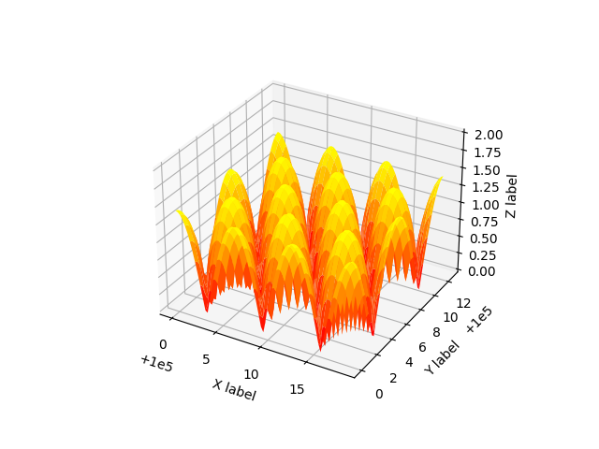
Trippy 3D

Slide 9
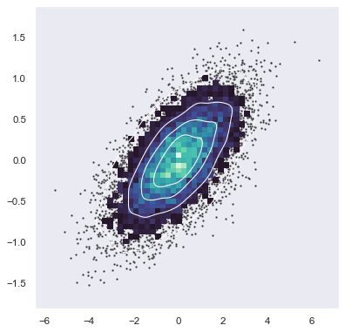
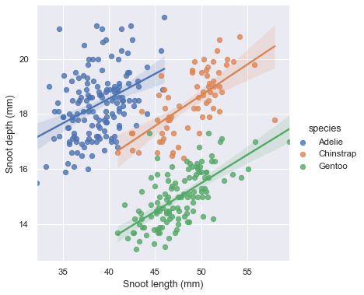
Mind-scattering Scatters

Slide 10
Let’s get doing

